Slide 1
Obesity and
Bariatric Surgery Clients
Facilitated by: Beverly Swann, MFT
www.beverlyswann.com
therapy@beverlyswann.com
925-705-7036

Slide 2

PLEASE NO:
Cell phones ringing
Texting during class
Arriving late
Holding back questions/comments

Slide 3

Let’s Get Started
Logistics
Introductions / Expectations
Learning Objectives
Vision
What is necessary to be successful in treating this
population
Notes:
Introduce self:
MFT specializing in trauma and eating disorders, specifically obesity, compulsive eating, and binge eating as well as chronic abuse and PTSD
Private practice and on staff at Casa Serena
Currently PhD student in Health Psychology
Obese – brief history of weight and becoming therapist

Slide 4
Introductions / Expectations
Your name / credential
Work you do (brief)
Expectations for the class
Notes:
So very much about this topic could be much longer class or 2 classes. Will try to steer you toward more resources wherever possible.

Slide 5
Learning Objectives
Participants will be able to :
Demonstrate an understanding/felt sense of the experience of being obese.
Identify and manage their own counter-transference issues around weight and obesity.
Name and describe the types of bariatric surgery along with the medical risks and outcomes.
Describe the different levels/classes of obesity and their medical and psychosocial consequences.
Apply techniques for individual and group treatment of obesity and clients who have had/are considering bariatric surgery.

Slide 6
Vision for this class
How class came to be…
Present the concept that obesity is a symptom of underlying pathology, which changes the focus of treatment
Treatment planning depends on what the underlying issues are
Key concept - many people who are obese dissociate around eating, body image, and weight/size
CBT and surgery will not work in the long-term if the underlying issues are not resolved
Notes:
How class came to be:
Staff mtg at Casa Serena about 3 years ago, asked for suggestions to add to the program
Put in proposal – very excited
Developed syllabus, then started procrastinating
Struggled to develop until 2 weeks prior, when I realized that I had forgotten the passion and vision
More material than can cover in 10 hours, so would like to speed through a lot of the beginning part and present more on assessment and treatment
Please ask me to slow down or repeat if necessary
Parking lot
All handouts on my website, including presentation, info about group and other events
Willing to answer questions/share from personal experience where it is helpful

Slide 7
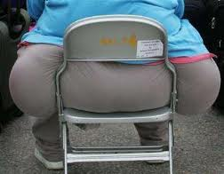
The Experience of Obesity
Guided Visualization
Notes:
What did you notice?

Slide 8
The Experience of Obesity
Physical Experience:
Don’t fit
Bumping into things
Overheating
Reduced skin sensitivity
Fatigue/weariness
Pain
Winded/difficulty breathing
Ill-fitting clothing
Emotional/Cognitive Experience:
Shame/self-loathing
Guilt
Loss of joy
Social isolation
Self-consciousness
Negative self-talk
Dissociation
Mental fog
Notes:
Discussion – what else did you notice during experiential?
* Need someone to do lights please
* Video 1 Some experience on being fat

Slide 9
What is necessary to successfully treat this population?
Therapist needs to examine and manage own prejudice and preconceived beliefs about weight, diet, exercise
May have to face own eating disorder/dysfunction
Understand that if diet/exercise programs worked for this client, he or she would not be in your office
Wear same clinical hat you would with any other client
No Shame / No Blame
Sensitivity towards intense needs for safety and comfort
Unconditional Positive Regard
Notes:
Remember this as we move through class – all other material relates to this slide!

Slide 10

Common mistakes therapists make
Ignoring the issue of obesity
Downplaying when client brings it up
Embarrassment
Just another “nagging voice”
Potato chip story
(not listening to the client)
Playing amateur dietician
Problem-solving
Not referring out when appropriate

Slide 11

Counter-Transference
Questionnaire and Discussion
Notes:
- Notice photos as we go through class and note thoughts/self-talk that comes up

Slide 12
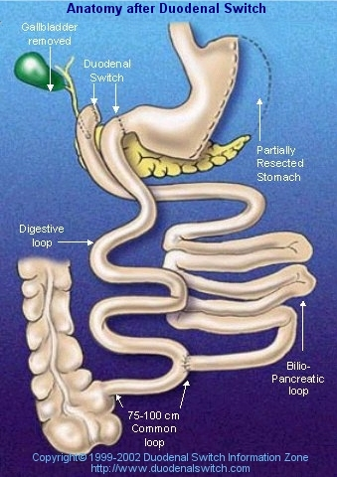
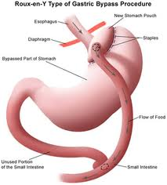
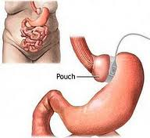
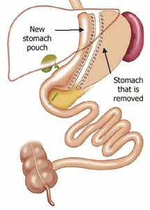
Types of bariatric surgery
Biliopancreatic diversion (duodenal switch)
Roux-en-Y (gastric bypass)
Lap Band (adjustable gastric banding)
Gastric Sleeve (sleeve gastrectomy)
Notes:
2 YouTube videos
Video 6 Cathy preop

Slide 13
Definition
Obesity - a condition characterized by the excessive accumulation and storage of fat in the body (Merriam-Webster Dictionary)
World Health Organization (WHO)
  a BMI greater than or equal to 25 is overweight
  a BMI greater than or equal to 30 is obesity.
    Class 1 (low-risk) obesity, if BMI is 30 - 34.9
    Class 2 (moderate-risk) obesity, if BMI is 35 - 39.9
    Class 3 (high-risk) obesity, if BMI is equal to or greater than 40
Centers for Disease Control (CDC)
  Overweight and obesity are both labels for ranges of weight that are greater than what is generally considered healthy for a given height. The terms also identify ranges of weight that have been shown to increase the likelihood of certain diseases and other health problems. BMI as above in WHO.
Notes:
INR Classes on Obesity and Stress & Eating – refer to Bibliography

Slide 14
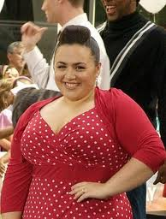
Statistics – U.S.
Over one-third of U.S. adults (35.7%)
are obese. (CDC 2012)
Approximately 17% (or 12.5 million) of
children and adolescents aged 2—19
years are obese. (CDC 2010)
Male/female (NIH 2008) – obesity rate among:
Women: 64.1 percent
Men: 72.3 percent
65% of the world's population live in countries where overweight and obesity kills more people than underweight. (WHO 2010)

Slide 15
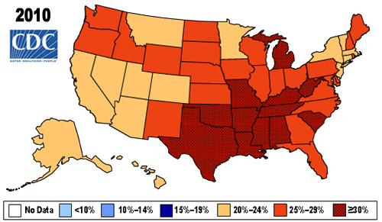
Statistics

Slide 16
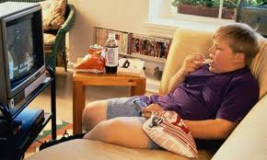
Childhood/adolescent obesity
The “obesity epidemic” – 17% of all children and teens
Loss of activity – school budgets, less walking, television, and video games
Fast food
Earlier onset of
medical conditions
likely to cause more
severe problems in
adulthood and possibly
early death
Notes:
* 2 Video Kids & Obesity

Slide 17
Obesity – Medical or Psychological?
Traditionally treated as medical problem – diet, medication, surgery
Psychological diagnoses:
  Binge Eating Disorder (307.51) - eating much more rapidly than normal, eating until feeling uncomfortably full, eating large amounts of food when not feeling physically hungry, eating alone because of feeling embarrassed by how much one is eating, feeling disgusted with oneself, depressed, or very guilty afterwards, marked distress regarding binge eating is present.
  Other Specified Feeding or Eating Disorder (307.59) – Symptoms that cause significant distress or impairment but not full criteria for other disorders. Includes distorted body image, binge eating, restricting behaviors, obsession with weight/size, sense of lack of control over eating, other eating behaviors that interfere with normal life functioning
  Unspecified Feeding or Eating Disorder (307.50) – Symptoms but choose not to specify (ER situations)
Notes:
Many obese people actually restrict/binge cycle, ex: wake up in morning swearing to not eat all day or “be good on my diet”, by afternoon starving then binge
My experience of starve until I was about to pass out, then binge as only way to eat

Slide 18
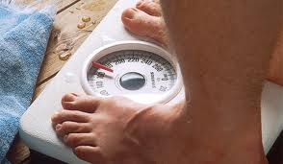
Measurements
Body mass index (BMI) is a simple index of weight-for-height. It is defined as a person's weight in kilograms divided by the square of his height in meters (kg/m²).
Does not account for age, body frame, gender, or muscle mass
Adult BMI Calculator –
www.cdc.gov/healthyweight/assessing/bmi/adult_bmi/english_bmi_calculator/bmi_calculator.html
Child/teen BMI Calculator - apps.nccd.cdc.gov/dnpabmi/

Slide 19

Measurements
Height/weight charts
  http://www.heightweightchart.org/
  Often does not account for age, body frame, or muscle mass
% body fat – calculates how much of your total weight is from fat tissue
  Measurements or special scales
  For women between age 20 and 40, 19% to 26% body fat is generally good to excellent. For women age 40+ to 60+, 23% to 30% is considered good to excellent.
  For men between age 20 and 40, 10% to 20% body fat is generally good to excellent. For men age 40+ to 60+, 19% to 23% is considered good to excellent.

Slide 20
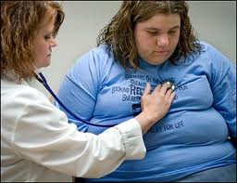
Obesity - Medical risks and complications
In 2008, medical costs associated with obesity were estimated at $147 billion; the medical costs paid by third-party payors for people who are obese were $1,429 higher than those of normal weight. (CDC)
Diabetes Type II
Heart disease/stroke
Joint pain and deterioration/
arthritis
Increased risk of some
cancers
Sleep apnea

Slide 21
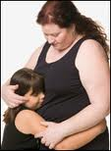
Genetic and environmental factors
Multiple genes responsible
for body composition:
  Body mass
  Frame size
  Energy intake/expenditure
  Fat storage
  Hunger/fullness
Environment:
  Food availability
  Family and cultural patterns/beliefs
  Trauma and/or life events
  Substance use
Obesity is likely caused by a combination of both

Slide 22
Cultural factors
Non-Hispanic blacks have the highest rates of obesity
(44.1%) compared with Mexican Americans (39.3%), all Hispanics (37.9%) and non-Hispanic whites (32.6%). (CDC 2010)
In some cultures, excess weight = affluence
Education/socioeconomic status (CDC 2008):
  Among men, obesity prevalence is generally similar at all income levels, however, among non-Hispanic black and Mexican-American men those with higher income are more likely to be obese than those with low income.
  Higher income women are less likely to be obese than low income women, but most obese women are not low income.
  There is no significant trend between obesity and education among men. Among women, however, there is a trend, those with college degrees are less likely to be obese compared with less educated women.

Slide 23
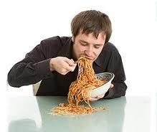
Dysfunctional Eating
Mindless Eating
Eating Alone
Food Rules
Food Phobia
Emotional Eating
Hiding Eating
Eating to Stuff Emotions
Stress/Anxiety Eating
Comfort Food Eating
Incoherent Eating
Binge Eating
Uncontrolled Eating
Compulsive Eating
PMS Eating
Food Aversion
Holiday Eating

Slide 24
Psychological issues
Self-care
Self-soothing
Self-regulation
Self-esteem
Body image problems
Body dysmorphia
Anxiety management
Social isolation
Unhealthy self-regulation = “distorted self-comforting gesture, a kind of attempt to hold, stroke, or soothe”
Addiction = “a movement away from our direct body experience of the real world”
Christine Caldwell – Getting Our Bodies Back (1996)
Notes:
* 4 Inside Life video

Slide 25
Psychological issues - dissociation
“It is…in the absence of reliable internal signals about when, how much, and what to eat that eating in this culture becomes such a painful and confusing event.”
Bloom et. al. (1994)
Fat as protection = link between being overweight and history of sexual abuse and/or rape
“…[living] like renters in a small room of a house we consider barely habitable.”
John Conger (1994)

Slide 26

Common distorted beliefs:
Fat is protection
Thin feels vulnerable
Food = love
I don’t deserve good things
I’m a failure
I’ll never be good enough
I’m fat = no one will ever love me
I deserve to be punished, i.e., I have to eat “bad” foods
I deserve a treat, i.e., I get to eat “bad” foods

Slide 27
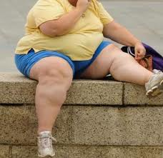
Psychosocial issues
Guilt – may be spending a lot of money on food and diet programs; religious beliefs around gluttony; less ability to be part of family
Shame – may feel ugly, lazy, weak, not good enough
Social anxiety – so focused on size that unable to participate
Social isolation – may stay home rather than face rejection
Bullying – obese children face cruelty and ostracism

Slide 28
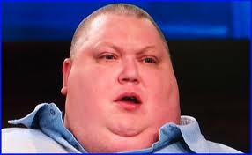
Psychosocial issues
Learned patterns of helplessness – “it’s genetic,” “it’s my metabolism,” “I can’t afford the right food to lose weight,” etc.
Ambivalence, or pretending not to care
Love/hate relationship with food
Yo-yo dieting
Diet trauma
Inactivity

Slide 29

Homework
Think about what your counter-transference issues may be
Notice any thoughts/images/memories/ ideas/sensations that come up around content so far
Think about obese family members and friends – what words do you typically use to describe them?
What is your “non-PC” judgment around eating and weight in others and yourself?

Slide 30
Impact of guilt/shame
Obesity is significantly related to depression, which is often a result of chronic shame
Less likely to engage in physical activity
Less likely to engage in social events
Often feel they can’t move forward with life plans
May respond to feelings of guilt and shame by numbing out with food/bingeing
May be discriminated against for jobs, promotions, etc.

Slide 31

Self-care issues
Lack of self-care – clients fail to care for their whole persons, including: eating properly, engaging in physical activity, securing enough rest time, following prescribed medical regimens, and ensuring time for relationships and fun.
Common theme is lack of self-love or feeling worthy of care.

Slide 32

Diet trauma
Concept that repeated dieting leads to:
intense preoccupation with food
powerful food cravings
deprivation-driven eating
compulsive eating
eating disorders
weight regain
www.nourishingconnections.com/recovering_from_diet_trauma.html
2006 study by FDA, FTC, and NAAG showed that 95% of people who go on a traditional/commercial diet plan will either quit or regain the weight lost within 5 years. Often they end up weighing more than when they began

Slide 33
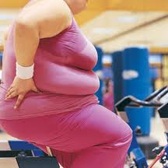
Exercise resistance
Many overweight clients do not like to exercise
Physically difficult/hard to breathe
Don’t like to wear exercise clothes
Learned to dislike as an overweight or non-athletic child
Feels like a “should”
Lost the joy of movement

Slide 34

Eating Disorder Questionnaire (EDQ)
Complete at home tonight
Discussion tomorrow

Slide 35

Bariatric Surgery –
Medical risks and complications
Risks associated with the surgical procedure can include:
Excessive bleeding
Infection
Adverse reactions to anesthesia
Blood clots
Lung or breathing problems
Leaks in gastrointestinal system
Death (rare)
Longer term risks and complications of weight-loss surgery vary depending on the type of surgery. They can include:
Bowel obstruction
Dumping syndrome, causing diarrhea, nausea or vomiting
Gallstones
Hernias
Low blood sugar (hypoglycemia)
Malnutrition
Stomach perforation
Ulcers
Vomiting
Death (rare)
Notes:
Video 7 Cathy Surgery

Slide 36
Success rates and long-term outcomes
Comprehensive, long-term outcome data not yet available
Most data published by biased parties
Most people do lose significant weight initially
Many see improvements in health conditions
Study over 10+ years = the failure rate when all patients are followed for at least 10 years was 20.4% for morbidly obese patients and 34.9% for super obese patients. These patients showed rapid weight loss in the 1st 2 years, then began regaining (Christou et. al. 2006)

Slide 37
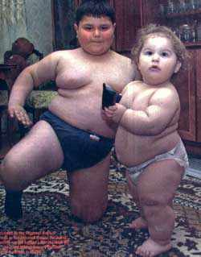
Children and adolescents
Some surgery as young as age six, reserved for extreme cases
In most cases, wait until after onset
of puberty (ages 12-18)
Ethical issues – decision made
that will affect child for life
Not enough data on long-term
outcomes yet
Notes:
Video 8 Kids & surgery ? - skip if running late
Case example of 8 yo w/seizures and brain damage

Slide 38
Assessment for surgical candidates
Strict selection criteria (Frisch, et. al. 2011)
Pre- and post-operative assessments
Determine co-morbid disorders that may be barriers to successful changes in post-op diet compliance
Battery of psychological tests: SCID for Axis I and Axis II; MMPI; pre-surgical readiness assessments; weight- and eating-related assessments; surgical outcomes assessments
Assess family/home environment for support
Notes:
Video 5 Dominique surgery (after slide)

Slide 39
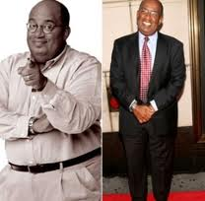
Psychosocial concerns
Post-surgical diet restrictions require client to substantially change the way he/she eats, resulting in changes in social relationships and events and changes in coping skills
Client never feels “normal” or like other people again
Continued problems due to pre-existing psychological issues
Poor post-surgical follow-up from programs that are focused on profit/loss
Post-surgery client may need to develop self-image and social skills
During rapid weight loss phase, strong body dysmorphia common

Slide 40

Psychotherapy for surgery candidates
Assessment
Before
During/immediately following
After
Family Therapy
Marriages/relationships often change after surgery
Develop self-care skills and other ways of coping
Adjust to new body, new social status, new lifestyle

Slide 41
Eating disorders after surgery
Symptom substitution – developing different addiction rather than resolve unhealthy coping mechanisms or stress of changes cause need for maladaptive coping skills
Developing bulimia – post-surgery nausea and vomiting may lead to deliberate eating and vomiting in order to eat more/inappropriate foods
Surgery is not a cure for bulimia, binge eating disorder, or compulsive overeating
Development of food aversion or restrictive food rules

Slide 42

Assessment
Co-occurring disorders
Diet trauma
Developmental issues
Cultural issues
History of trauma
Health condition
Eating disorders
Current family situation
Self-care patterns – sleep, exercise, etc.
Client readiness for treatment
Notes:
Video 9 Dominique Denial

Slide 43

Co-occurring disorders
Comorbid Axis I disorders 27-42% of patients seeking surgery; (former) Axis II disorders 22%
Binge Eating Disorder (BED)
Post-traumatic Stress Disorder (PTSD)
Depression / Anxiety
Addictions – substance, shopping
Notes:
*3 Dominique Dysfunctional Eating

Slide 44
Developmental issues
Prenatal – how/when/why did mother eat while pregnant?
Developmental trauma
Family eating patterns - “Family meal myth”
Attachment issues – “Food = love”
Learned dissociation – parent w/PTSD or depression
“In most abusive homes children are neglected in one way or another and, in the absence of good-enough experiences with food, they simply do not learn to feed themselves.” Bloom et. al. (1994)
Notes:
Story about “family meal myth”

Slide 45
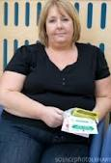
Effects of trauma
Rape
Incest
Physical abuse
Domestic violence
Traumatic events
Munchausen by proxy victim
Links between PTSD, obesity, diabetes, and metabolic syndrome

Slide 46
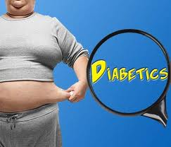
Health condition
Physical exam
Bloodwork
Physical restrictions
Health history
Medications

Slide 47
Assessment – Screening Tools
Eating Disorder Questionnaire (EDQ)
Addiction Severity Index (ASI)
Adult ADHD Self-Report Scale (ASR-v1.1)
Alcohol Use Disorder Identification Test (AUDIT)
Michigan Alcoholism Screening Test (MAST)
Drug Abuse Screening Test (DAST)
Beck Depression Inventory (BDI)
Beck Scale for Suicide Ideation (BSS)
Beck Anxiety Inventory (BAI)
Brief Symptom Inventory (BSI)
Mood Disorder Questionnaire
URICA (readiness to change)
FRIEL Co-dependency Inventory
Multiscale Dissociation Inventory (MDI)

Slide 48
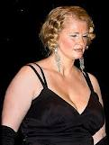
Assessment case study
Jena is a 38 year old client presenting with depression. During an initial session, she mentions she’s always wanted to be beautiful and would have a better chance of getting a man if she lost 50 lbs. She reports she’s tried “every diet under the sun” but she thinks she has a thyroid problem. She says “I don’t know why I don’t lose weight…I really don’t eat that much.” She startles when there is a noise by a passing truck outside.

Slide 49
Counter-transference check-in
Snack discussion
  If you had a snack over the break, what did you choose and why?
  Did you judge others? Yourself?
  How would you talk to a client who was beating herself up for choosing the “fattening” snacks?
  How would you talk to a client who was congratulating himself for choosing only the “good” foods?
Anything else that has come up over the course of the day?

Slide 50
Treatment goals
Let go of diet mentality
Realistic expectations about:
  Goal weight – partner with PCP and dietician
  Rate of weight loss
  Body type / age / life events
Normalize slow, steady loss over time
Focus on lifestyle changes rather than numbers on the scale
Notes:
Video 10 Dominique regain

Slide 51
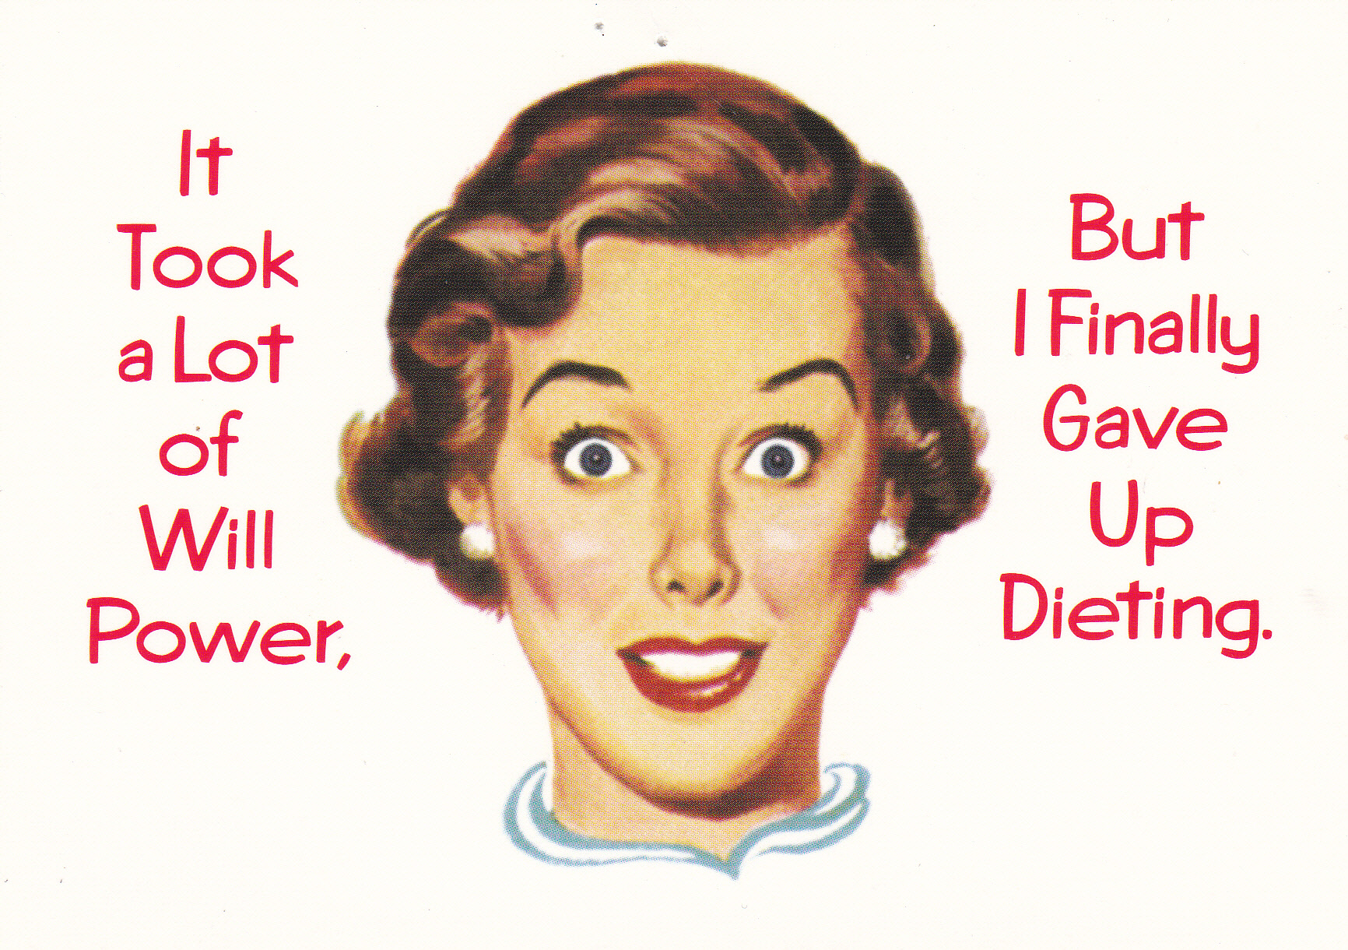

Slide 52
Levels of Care
Outpatient – typically once a week therapy
Intensive Outpatient (IOP) – 3-4 days/week, half-day
Partial Hospitalization (PHP) – 4-5 days/week, full-day
Residential – 24/7 treatment,
client does not go home
Inpatient – 24/7 medical
treatment to stabilize patient
medically
Notes:
Clinicians often underestimate what is appropriate treatment or what insurance will pay for

Slide 53
Eating continuum
Feeding oneself is a nurturing act of taking in whatever will provide nourishment, energy, health, and aliveness. Eating is externally driven – pushing food into yourself in response to cues from society or in an effort to self-soothe.
Binge/Compulsive eating
Emotional eating
Dissociation
Mechanical eating
Medical requirements
Mindless eating
Holiday eating
Intuitive eating
Rigid eating
Obsessive
Notes:
Chair dance – Beach Boys?
Intuitive eating
Enlightened eating

Slide 54
Psychology of Eating
Emerging field
Institute for Psychology of Eating - http://psychologyofeating.com/
Recent online conference – recorded versions available for purchase: http://www.entheos.com/Eating-Psychology/entheos
New way of working with obesity?

Slide 55
Treatment issues – cognitive impact
Studies showing that increases in adiposity (body fat %) are associated with decreases in executive function and attention/focus (Willeumier et. al. 2011)
Combine this with fatigue/decreased energy and psychosocial issues
=
Depression
Lack of motivation
Dissociation
Helplessness

Slide 56
Treatment issues – physical impact
Being overweight increases likelihood of sleep apnea
Many obese people report sleep problems
Lack of sleep most likely contributes to retention of body fat
Shame of being overweight leads to constant stress
Constant stress results in chronic elevated levels of stress hormones, particularly cortisol.
Cortisol is linked to retention of body fat.
=
Treatment must include self-care and anxiety management

Slide 57
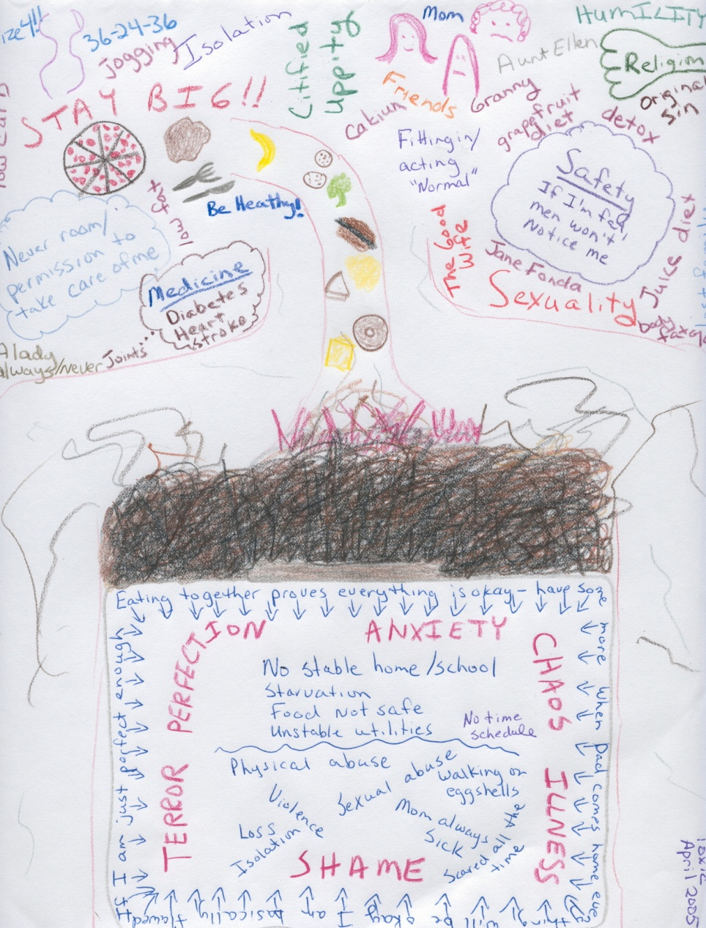
Treatment issues – emotional impact
Everything we’ve talked about so far
Affect blocking – stuffing emotions with food (article by Smith 2011)
Damage from diet trauma will need to be acknowledged and treated

Slide 58

Treatment theories/modalities
CBT/DBT
Person-centered
Somatic
EMDR
Movement therapy
Psychoeducation
Psychodynamic
Body image therapy
Bibliotherapy
Movie therapy
Drama therapy
Art therapy
Family therapy
Group therapy
Websites
Notes:
Interesting book on Person-centered
Psychodynamic – digging into root causes and determining if trauma related or developmental
Somatic – experiential, present focus around sensations and emotions of food choices, awareness of choice, how do I use these food choices to cope w/emotions?
Process of Change diagram

Slide 59
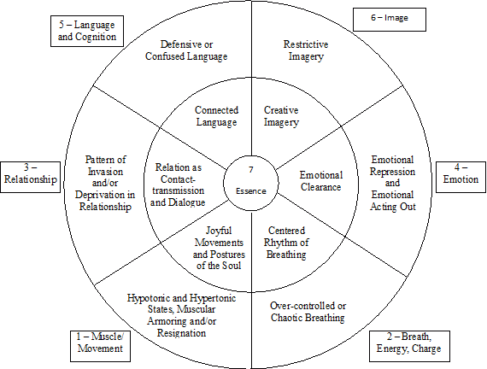
Treatment model –
Boadella’s Life Fields
Notes:
Examples:
Overemphasis in segment 4 Emotion – explore when/why this happens, exaggerate or reduce intensity, try on other ways
Traditional treatment has been focused on 3 Relationship, 5 Language and Cognition, and 6 Image. Balance out with equal work in other areas
Work in area 2 Breath, Energy Charge might be understanding when client has more energy and when she turns to food to “bump it up.”
Turn on iTunes?
Video – Dominique surgery ?
Handout – 7 Stages Life Fields

Slide 60
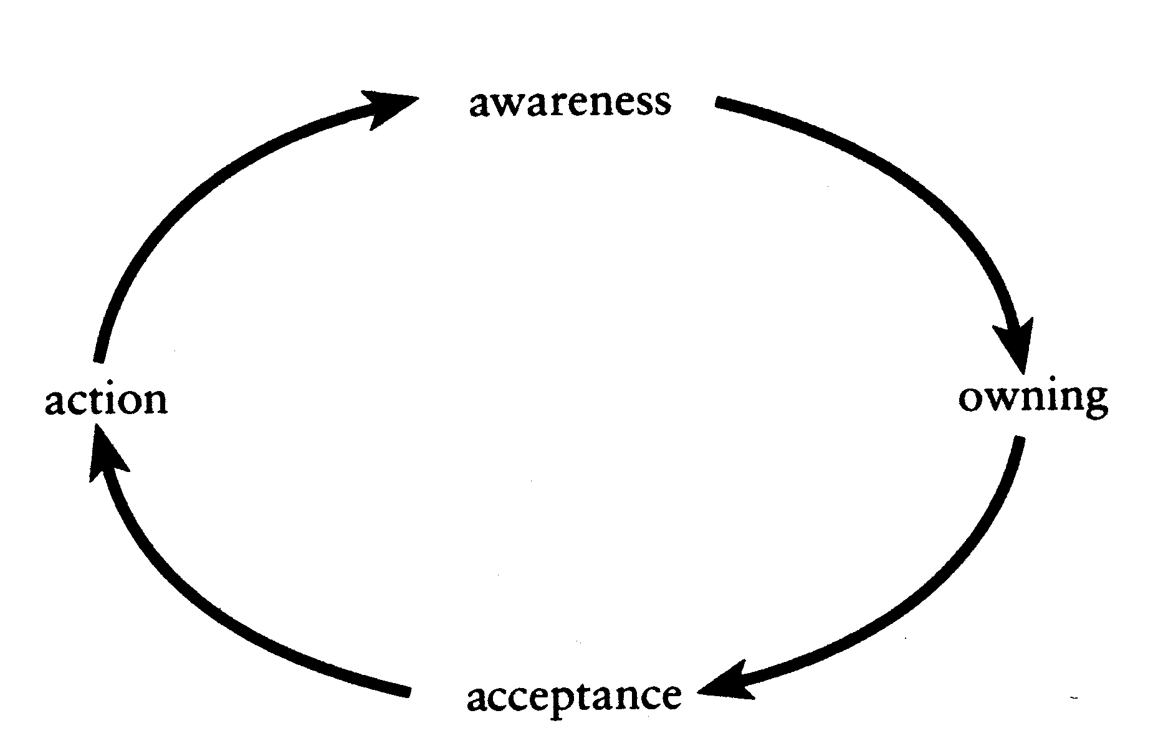
Treatment model – Caldwell’s Addictions
“The only way out of addiction is through it; through the feelings, through the sensations, through the old limits, further into the body that is our home.” (Caldwell, 1996) From Getting Our Bodies Back
Caldwell’s Moving Cycle
Addiction – “an act of poisoning a body we have come to hate because it is in our bodies that we experience pain, particularly the pain of need deprivation” (Caldwell, 1996)
Notes:
- Eating is addiction whenever it is primarily about anything other than nourishing the body and providing fuel.
Traditional obesity treatment focuses on “action” only. Successful treatment includes equal emphasis on all 4 stages.
Video 11 Dominique angry

Slide 61

Practical considerations for treatment
Accessibility – stairs, bathrooms, handicap parking
Furniture size – able to accommodate larger sizes and sturdy enough to stand up to larger amounts of weight
Waiting room - traditional waiting room chairs are often too small; clients may be very self-conscious with other people waiting
CPR certification – obese clients often have significant health problems
Don’t recommend things client isn’t able to do – most yoga classes
Don’t refer to things you’ve not vetted

Slide 62
Treating resistance
“According to common sense, there are only two possibilities; either we do not know what to do, or we know what to do and do it. Any real therapist knows that there is a third possibility – knowing what one should do, but being incapable of doing it. Here is where most of the time in psychotherapy is spent, finding out why it is that the patient cannot do what he believes makes sense.” (Karon 1976)

Slide 63
Approach to resistance
“…food is basic to security.” “Compulsive eaters lack an internal soothing presence to tolerate anxiety; they turn to food, as symbolic of the good mother, to find comfort and connection in order to allay anxiety.”
Bloom et. al. 1994
What does this tell us about resistance to treatment?

Slide 64
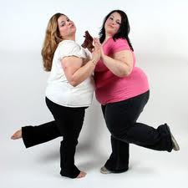
Boundaries
Moving closer/farther and examining how it feels
Awareness of boundaries of clothing, furniture, grocery aisles
Boundaries around fullness/hunger
Pushing against other – palms, backs, etc.

Slide 65

Movement therapy
Recapture joy of movement
    Stretching
    Play – jacks, paddle ball, jump rope
Grounding – use of long muscles (arms, legs)
Exploration and confidence
    Growing/shrinking
    High/medium/low levels
    Effort – exaggerate, cut by 50%, increase by 10%
Body image
    Chair yoga
Resistance to movement/exercise
    Near/far
    Push/pull

Slide 66
Barriers to movement
Believing since childhood that “I am not good enough” at movement or “I’m a klutz”
Feeling pressure to perform from parents or coaches that took away the joy of movement
Deciding to move my body as little as possible in order to avoid attention (safety)
History of injuries that cause physical pain when moving and fear of further injury
All-or-nothing attitude towards exercise (perfectionism)
Seeing movement only in terms of exercise to lose weight – a chore
Feeling overwhelmed by everyday demands of life (no time or energy for exercise)
Feeling rejected or ashamed because of body type or weight
Using exercise as punishment for eating too much
Flashbacks brought on by some movements or feeling sexual/sensual

Slide 67
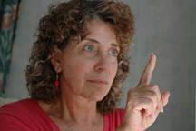
EMDR
Target eating behavior or weight issue, use protocols:
  Recent Incident (eating/bingeing)
  Level of Urge to Avoid (exercise)
  Future Template (upcoming eating event)
Process, with framework of focus on weight and eating
Resolve trauma and “stuck” places around losing weight and practicing good self-care

Slide 68
Guiding principles for treating co-occurring obesity and PTSD
SAFETY SAFETY SAFETY
Thorough assessment of client’s actual physical condition and abilities
“Invite” rather than “I want you to…”
Promote empowerment in the body and using the body as a resource – long muscles
Promote awareness of size and location in time and space, dealing with hurt, shame and grief as it comes up
Avoid using breath as grounding work until client is solidly resourced
Acknowledge that food IS comforting
Notes:
If time allows, demo using “long muscles” and grounding without breathing

Slide 69

CBT
H = Hungry – am I physically hungry?
A = Angry (or other emotion) – am I emotionally hungry?
L = Lonely – am I lonely?
T = Tired – do I need sleep rather than food?

Slide 70
Other Tools
Hunger/Fullness Scale – Help client to learn internal sensations around hunger and differentiate them from other kinds of “hunger” or help client who never feels full
Food/Mood Log – Take emphasis away from calories and amounts and shift to triggers, internal cues, and eating patterns
Reframe binges as working relapses – borrowed from other 12 step programs – “Progress not perfection”
“What Works” exercise

Slide 71
Coordination with professionals
It can be difficult to find people in other professions who understand obesity and eating disorders. Learn how to gently educate others and gain their collaboration
Primary care physicians (PCP) – for basic physical and bloodwork and to understand all medical conditions
Psychiatrist – medication information
Dietician/nutritionist – meal planning and education; intuitive eating
Notes:
Beware of “nutritionist”

Slide 72
Medication possibilities
Many drugs on the market to promote weight loss – tend to produce rapid results but when patients stop taking drugs they tend to regain weight unless they have done significant work to change underlying issues (similar to surgery). Also concerns if client has other medical conditions
Psych drugs often promote weight gain (lithium, many antidepressants)
Over-the-counter medications – mostly stimulants, potentially dangerous
Supplements – totally unproven and possible side effects
Notes:
“For the seriously overweight” ad

Slide 73

When to refer out
Out of Scope of Competence
Unable to manage counter-transference
Life-threatening condition and client unable to make changes
Client actively purging (always life threatening)

Slide 74
Local ED Treatment Centers
Casa Serena – IOP, Concord
Center for Discovery – Residential, Fremont
Cielo House – IOP,PHP, Belmont and San Jose
Herrick/Alta Bates – Inpatient/Outpatient, Berkley
La Ventana – IOP/PHP, San Francisco, San Jose, and Marin (some dual diagnosis treatment)
New Dawn – PHP, San Francisco (some dual diagnosis treatment)
Summit – IOP/PHP/Residential
Notes:
Mention Shelby and Priscilla – need their contact info

Slide 75
Alternative/complementary approaches
OA – Overeaters Anonymous
FA – Food Addicts in RecoveryAnonymous (?)
Herbalists
Accupuncture
Weight Watchers
JumpStartMD (?)

Slide 76

Role Play
Volunteers for: therapist and overweight client

Slide 77
Counter-transference one last time
Think back to when we first started yesterday afternoon – has
anything shifted?
What might you do differently with your overweight clients
next week?
Any last thoughts?

Slide 78

Wrapping It All Up
Question / Answer / Review
Beverly Swann, MFT
therapy@beverlyswann.com
www.beverlyswann.com
925-705-7036

